Slide 1
Dropout and Success: Student Data
Presented By
Sahadev Sutradhar
Bach No: ML3-DA23

Slide 2
Objective
To find Out Dropout and Success of Student.
To see Enrolment of Student in different Course.
Top 5 Course preferred by the Student.
Student for taking Debtor for their Course.

Slide 3




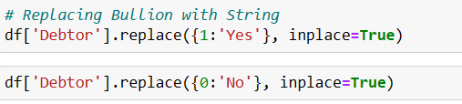
Data Cleaning & Pre-processing
Calculating Row and Columns
Checking information about DataFram
Checking the Null Values
Replacing Bullion with String of Marital Status
Replacing Course Bullion with String
Replacing Nationality Bullion with String of nationality
Replacing Gender Bullion with String of Gender
Replacing Debtor Bullion with String of Debtor

Slide 4
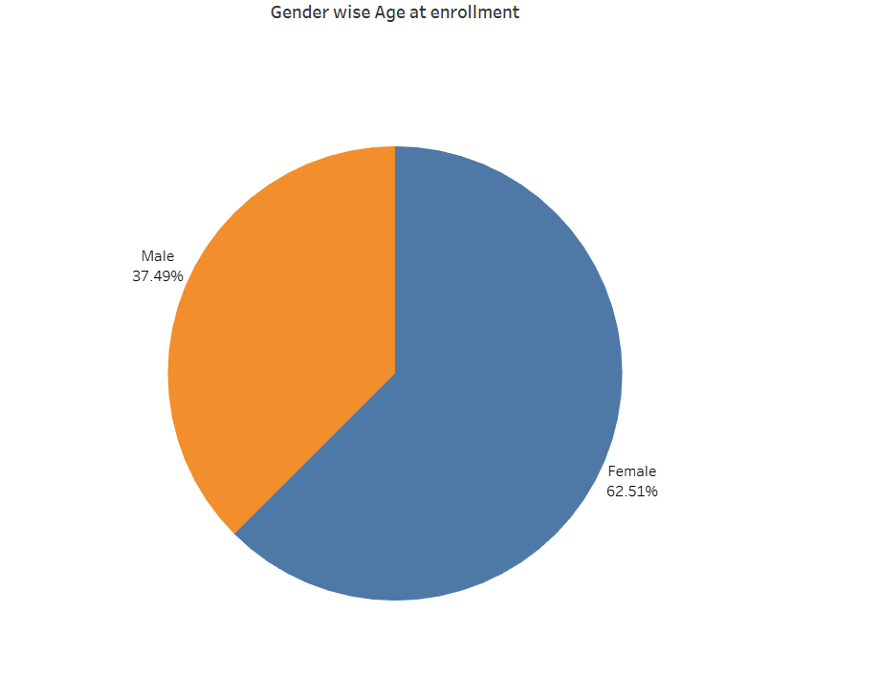
What are the Percentage of Male and Female Enrolment in the course?
Majority of the Student are Female.

Slide 5
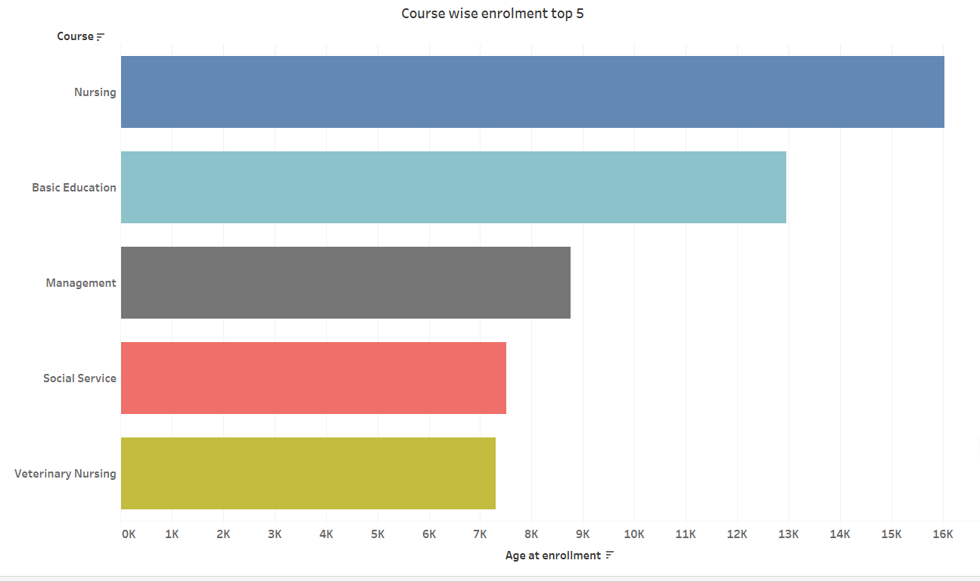
What are the top 5 Course will prefer by the Student?
Nursing is the most demanding course

Slide 6
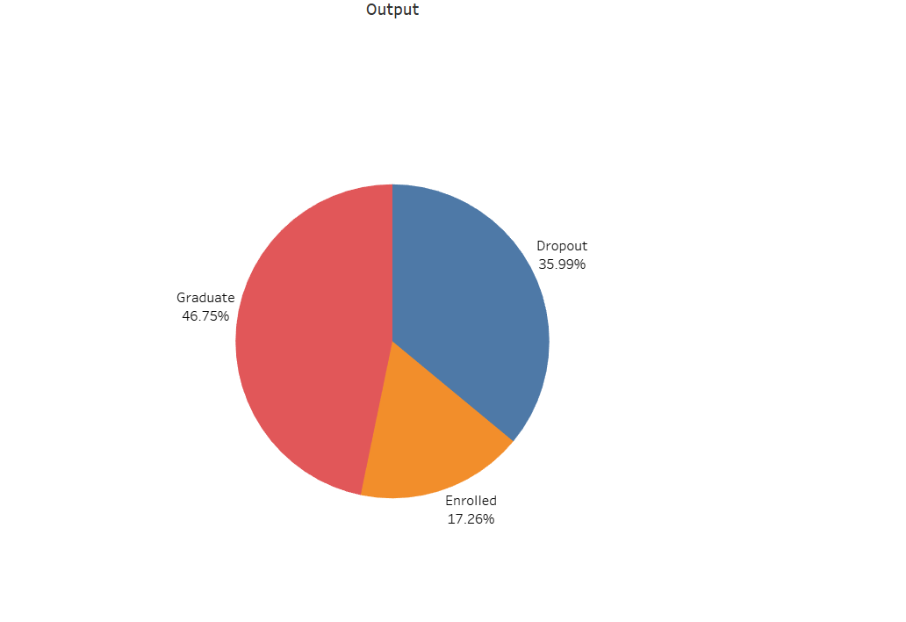
What are the Output off the Curriculum?
Maximum student have completed their Graduate, but the Dropout rate is higher

Slide 7
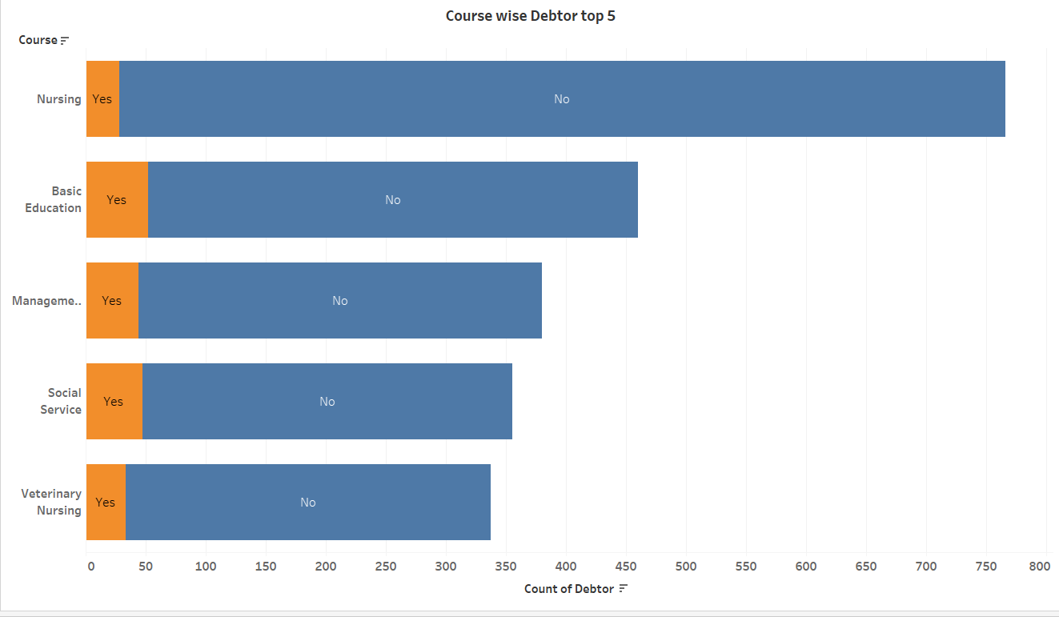

How many student are taking Debtor to Study in different Course top 5?
In Basic Education student are taking Debtor for their study

Slide 8
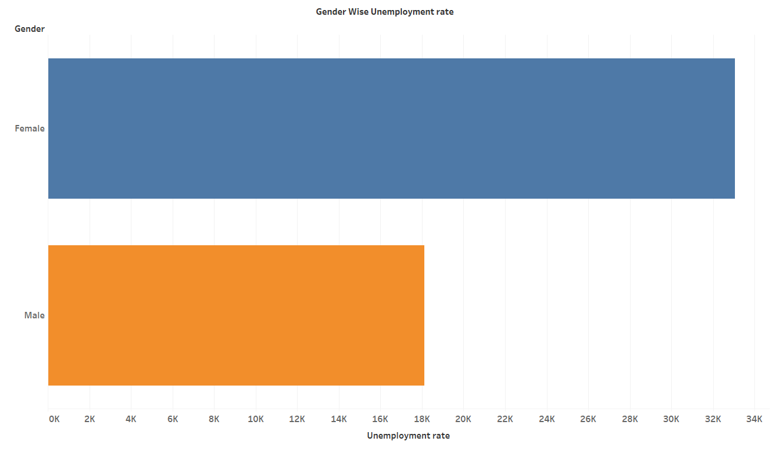
What are Unemployment rate in the Course Gender wise?
Female have the hight Unemployment Rate

Slide 9
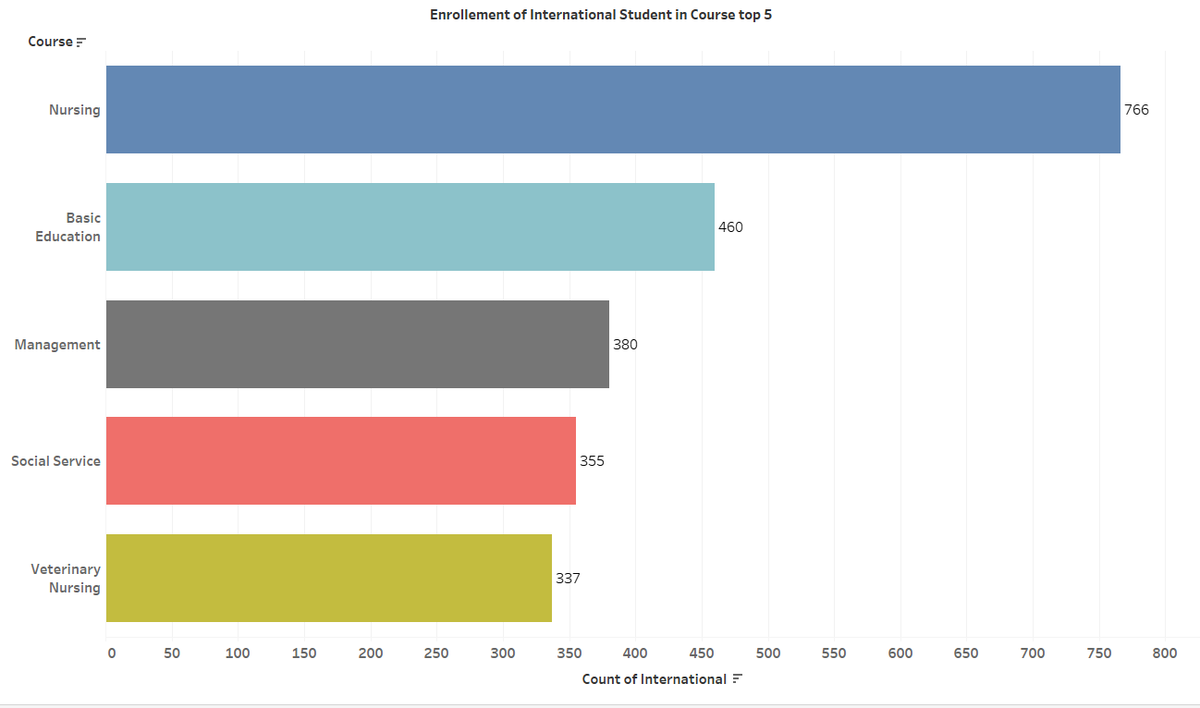
How many International student will Enrolment in the top 5 Courses?
Maximum International Student have preferred Nursing Course

Slide 10
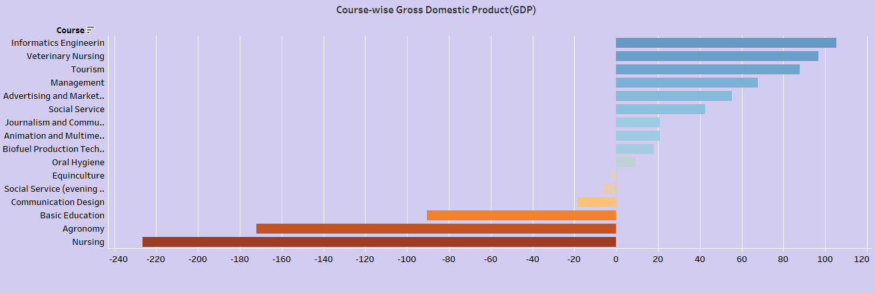
What are the Gross Domestic Product(GDP) in different Course??
Informatics Engineering have produced more student than rest of the Course

Slide 11
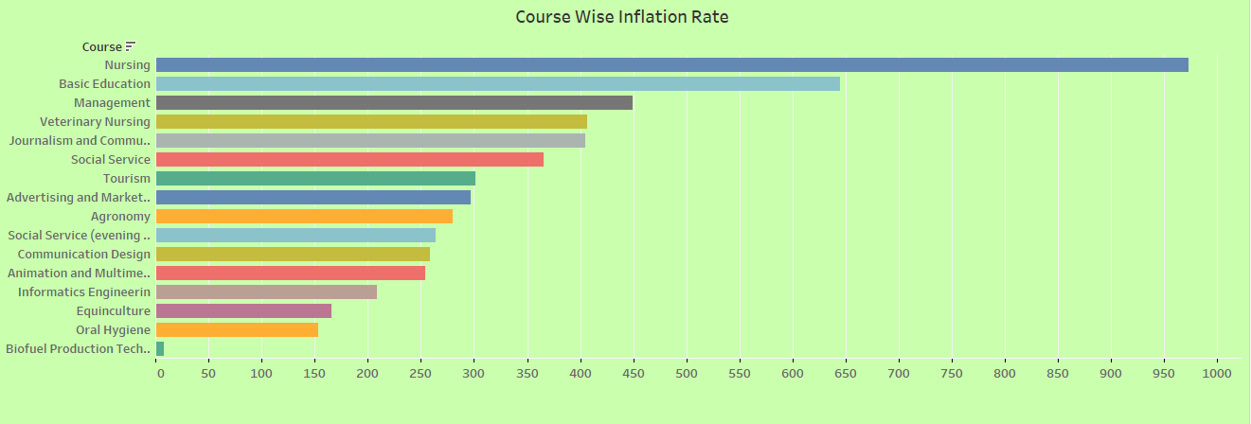
What are the inflation Rate of different Courses?
Nursing have the highest course fee than rest of the course

Slide 12
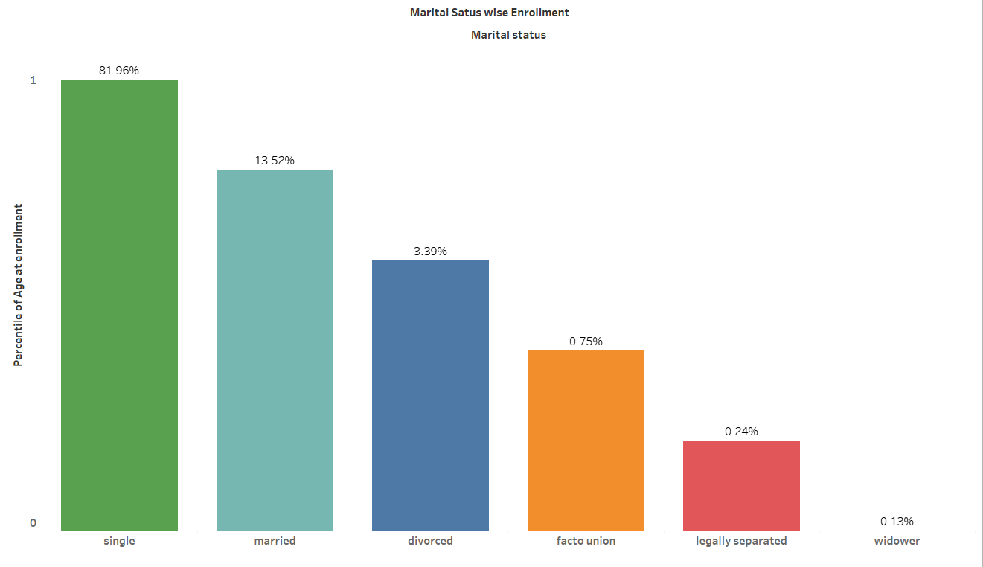
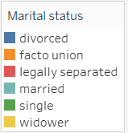
What are the Student Enrolment in the Courses according to the Marital Status?
Maximum Single Marital Status is joining the course

Slide 13
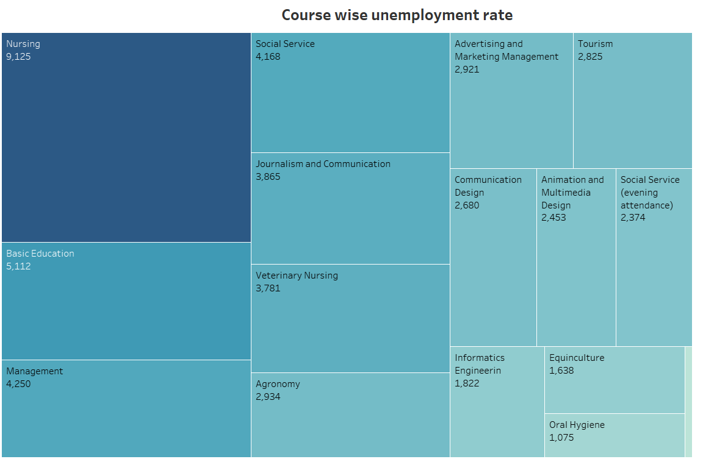
What is the Course wise Unemployment rate?

Slide 14
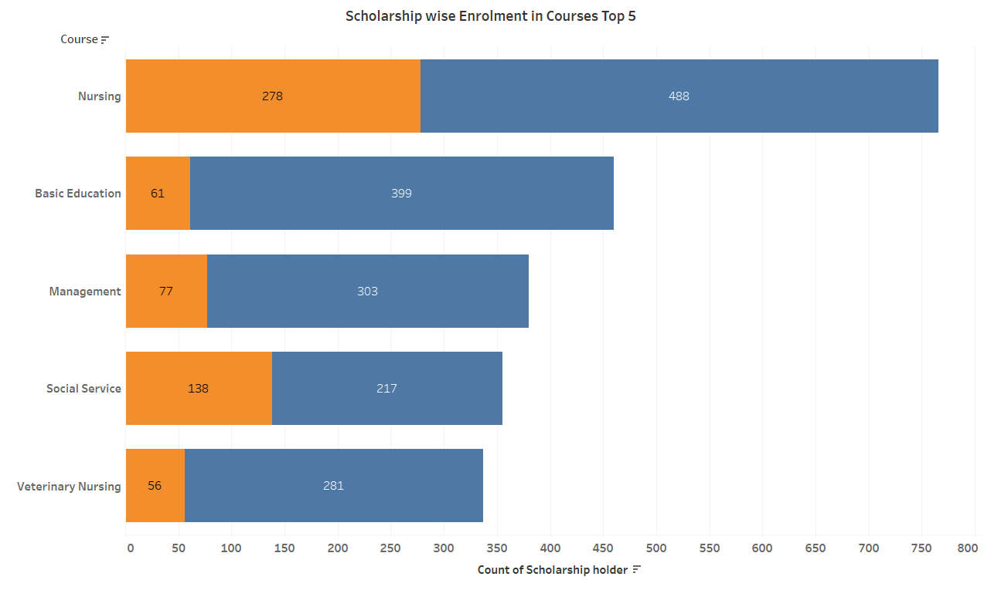

How many Student enter through Scholarship in the courses?
In Nursing student are joining through Scholarship

Slide 15
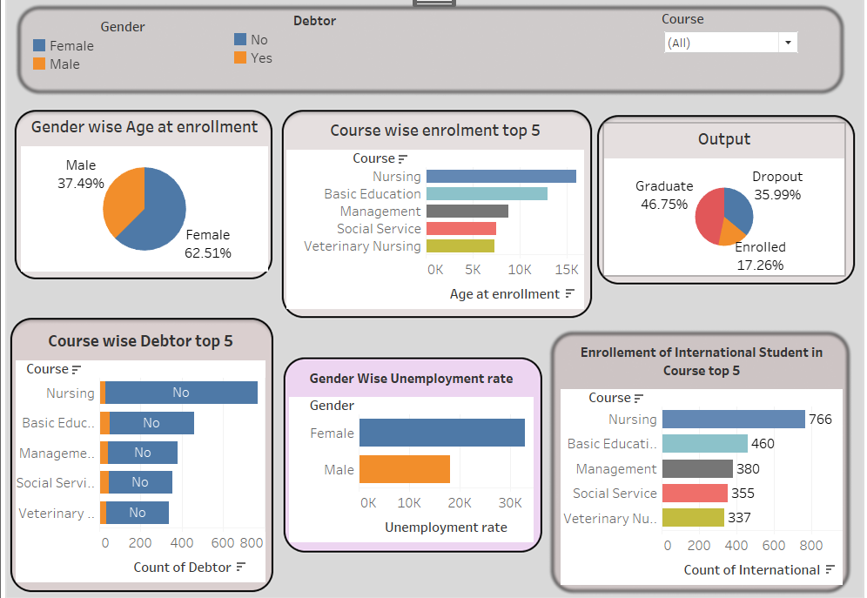
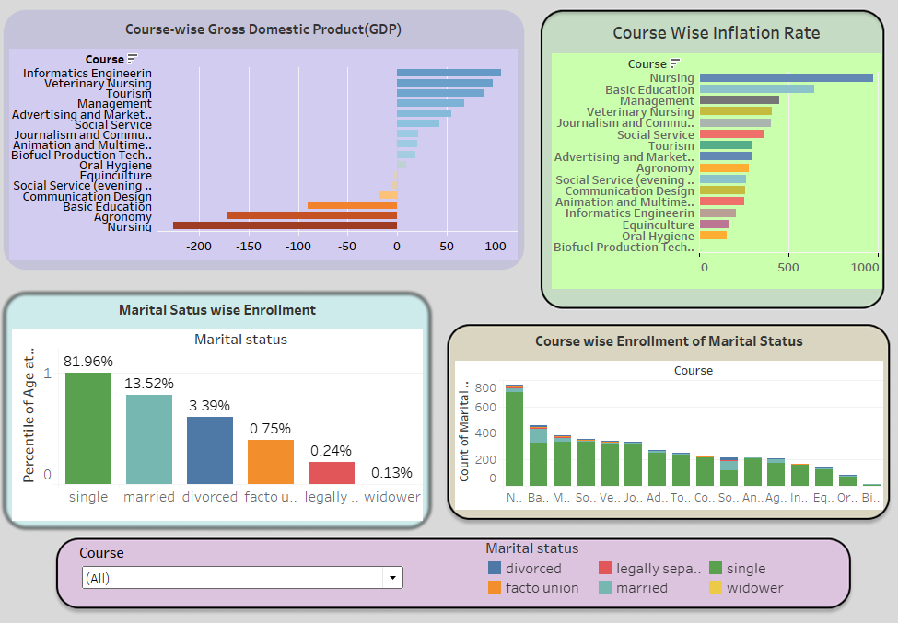
Dashboard created in Tableau

Slide 16
Summary
62.51 % of the Student are Female
Nursing is the most demanding course
46.75% student have completed their Graduate, but the Dropout rate is higher
In Basic Education student are taking Debtor for their study
Female have the hight Unemployment Rate
766 International Student have preferred Nursing Course
Nursing have the highest course fee in rest of the course
81.96% of the student are Single joining the course
In Nursing student are joining through Scholarship

Slide 17
Recommendation
Need to give Remedial class to the weaker student so the Dropout rate will be decrease.
Give training to the Female student so that they can get place in company.
Increase the number of International student.
Nursing, Agronomy and Basic Education need to increase their student capacity.
The course fee should decrease so that more student will enrol in the course.
Create some new class for the married, divorce, facto union, legally separated and widower.

Slide 18
Thank You

